Slide 1

Presented by
Vamsi Muvvala
Sarath Kanagala
Devi Venkat Kunchala
Prashanth Erugurala

Slide 2
The pain we have addressed
Hotels involve a lot of human intervention and face-to-face interaction with the staff, making the customers more prone to infections.
Customers face longer wait times during peak business hours.
Carrying keys with big RFID tags while leaving the room is a pain.
People sometimes forget their IDs in a hurry.

Slide 3
Solution using AI and Distributed Computing
A web application based that uses Artificial Intelligence to suggest the best hotel.
The application uses distributed systems so that it can be accessed simultaneously by thousands of customers.
The Check-ins will be human interaction-free leading to more safer hotel stays.

Slide 4
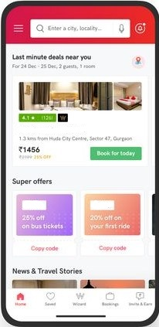
How our model works ?
Booking
Select a hotel room with best amenities from our collection
Make the payment
Get a QR Code

Slide 5
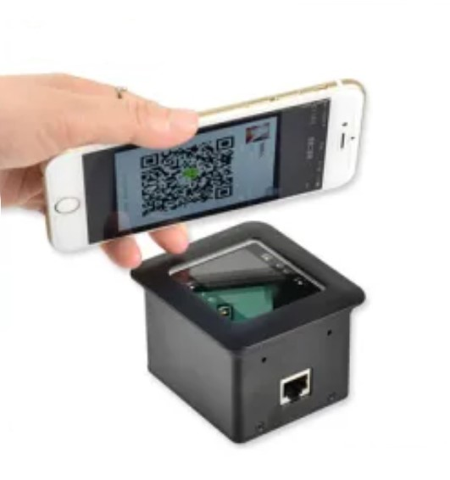
How our model works ?
Scanning
Scan your QR code at the hotel entrance’s GetInn Detector
The device takes a snapshot of you.
The time of your check-in for our record and safety measures.

Slide 6
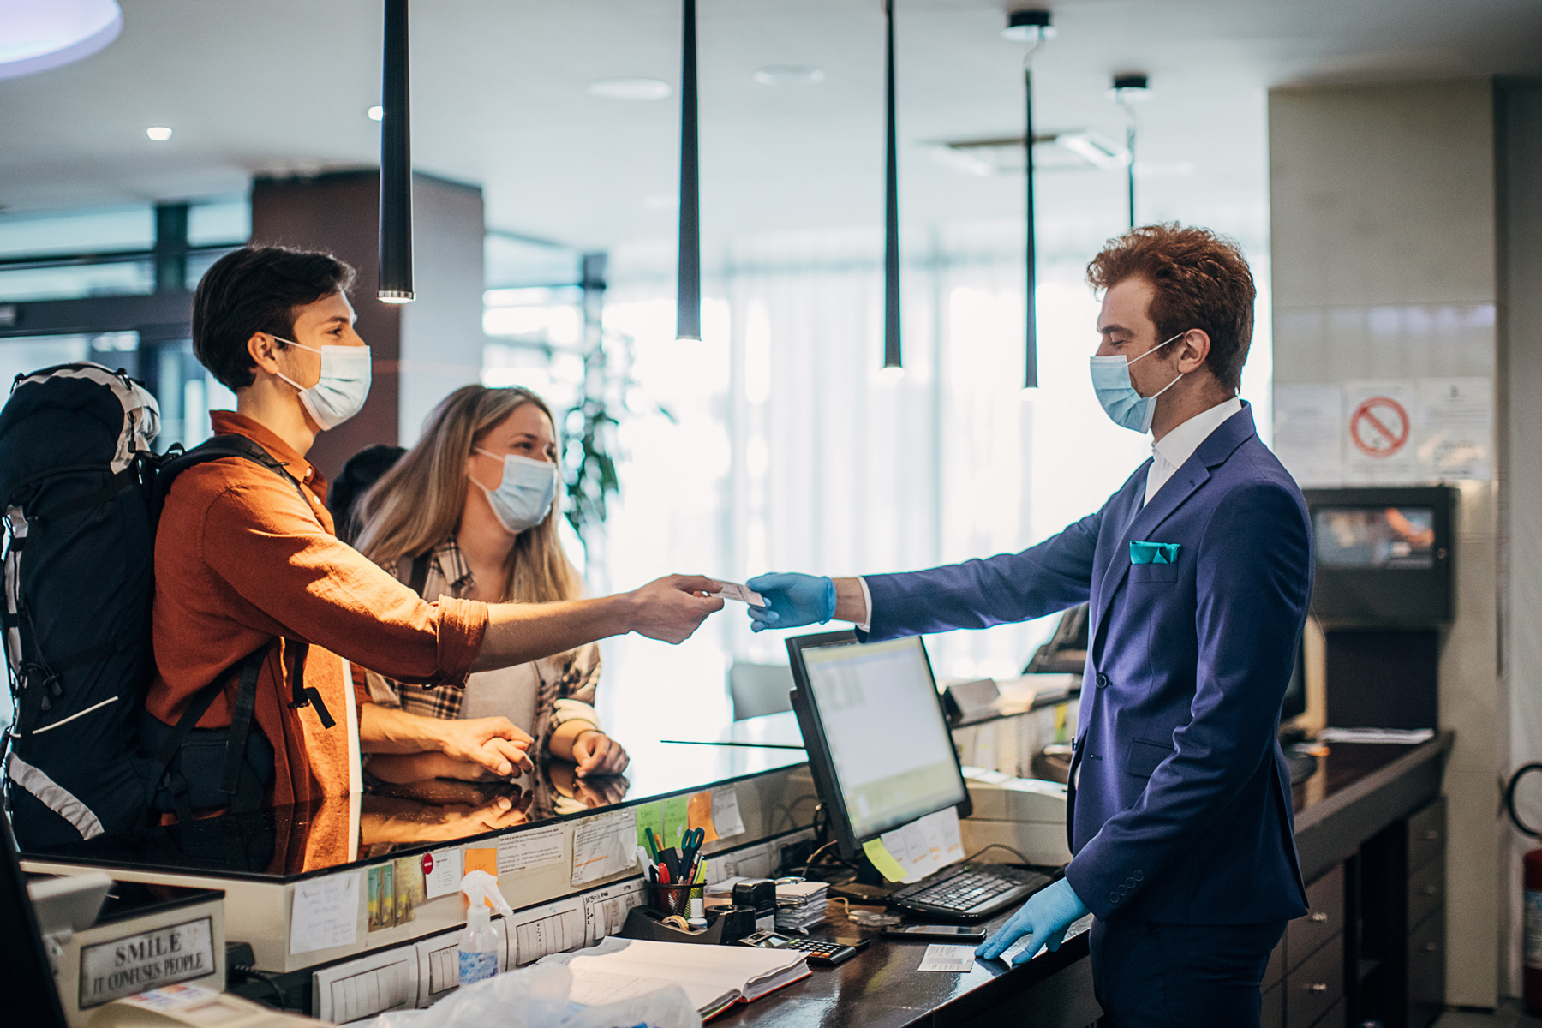
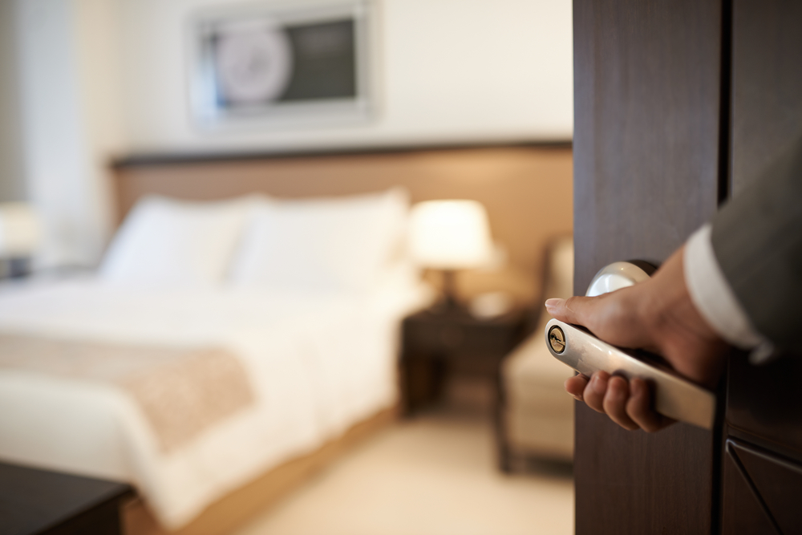
How our model works ?
Check-in
Now the QR code’s accepted and you’re all good to check-in
The customers can directly enter their room without actually interacting with reception staff.

Slide 7
Our model in comparison with others
During the pandemic hotel businesses have lost $46 billion in revenue in the US alone and hundreds of billion dollars around the world.
Surviving the pandemic is the only key means to keep the hotel their businesses running.
So, We have provided a business model which follow strict health protocols and practices.
 | GetINN | Treebo Hotels | Fab Hotels
Human Interaction | None | High | High
Wait times | None | Medium to high | Medium to high
Sanitization times | Time stamps | None | none

Slide 8
Our Target Market
Business personalities
Three Star and above level hotels
Premium resorts
Our Value Proposition
In the current pandemic situation, our model can bring consistent business to the hotels since it follows strict health protocols and fast and smooth process.
Hotels with our model will be future-proof and generates more revenue.

Slide 9
GetINN’s Business Model Canvas
Key Partners | Key Activities | Value Propositions | Customer Relationships | Customer Segments
3-star and above Hotels Premium Resorts
Easy bookings Interaction-free check-ins
Safe stays More business More revenue Future ready
Customer satisfaction as utmost priority
Tourists Business personalities Customers with On-the-go bookings
Key Resources
Channels
User Data User Feedback
Flyers Online Ads Word of mouth
Revenue Streams
Commissions from hotels and resorts. Advertising on our website.

Slide 10
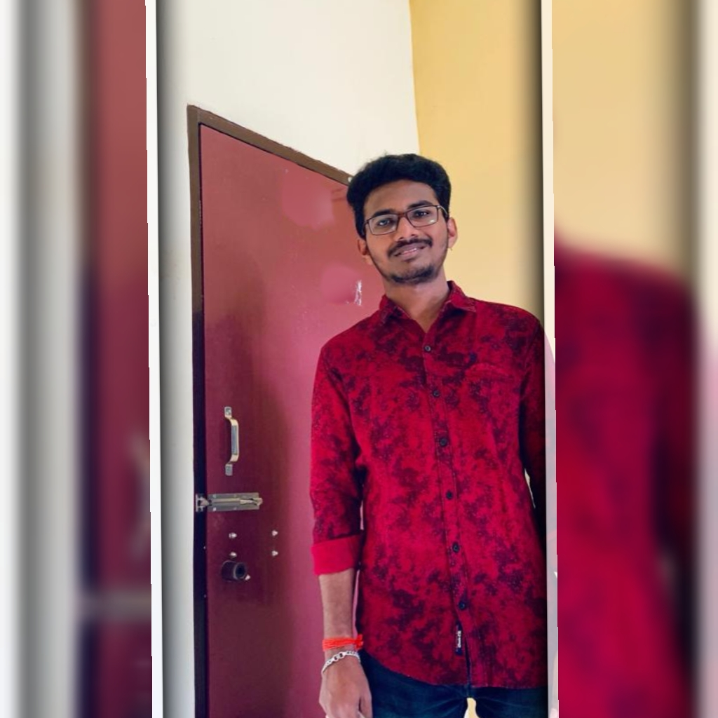


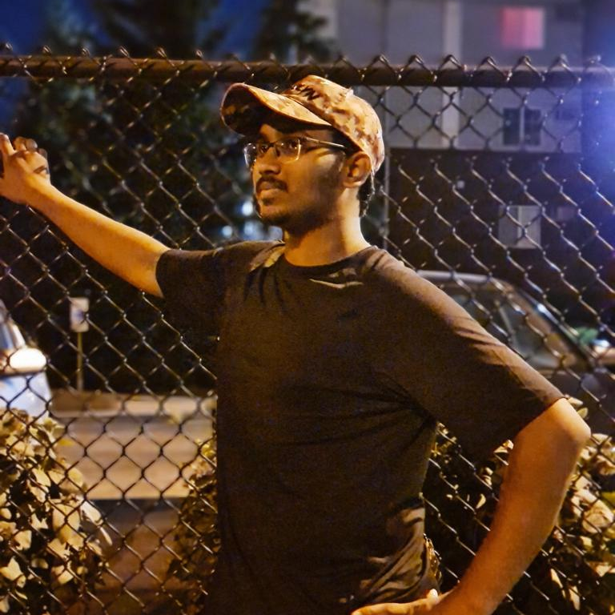
Devi Venkat Kunchala
Software Engineer
Prashanth Erugurala
UI Developer
Vamsi Muvvala
Data Analyst
Sarath Kanagala
Software Engineer

Slide 11
Plan of Action
October 1st
October 28th
November 4th
November 30th
December 9th
Idea & Desingning
Building the model
Development & Testing
Product Release
Scale-up

Slide 12


Tools used for Team development & Communication
Github for Product development
Zoom for Communication

Slide 13


